Slide 1
Intermediate R

Slide 2
Goals for Today
Downloading Rmarkdown
2
Notes:
2

Slide 3
Setting Up R Markdown

Slide 4
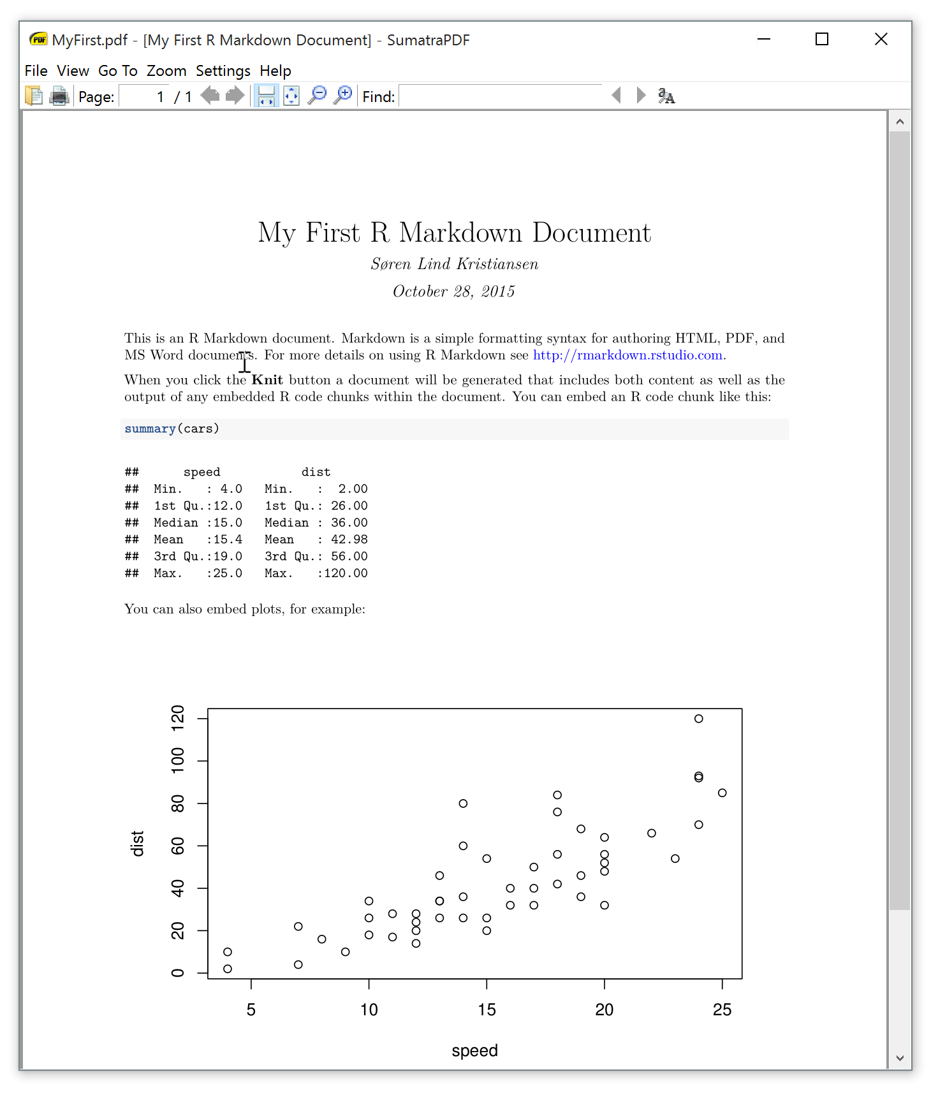
What is R Markdown?
R Markdown is a useful package that allows you to create a document directly in R, making it very simple to include equations, exhibits, outputs, or even code directly in your document. See cheat sheets and reference guides available at: https://rmarkdown.rstudio.com/
4
Notes:
4

Slide 5

Installing R Markdown
R Markdown is installed the same as any other package. Just type ‘install.packages(“rmarkdown”) into your R console.
5
Notes:
5

Slide 6
Typical Booth Workflow

Slide 7
Booth Workflow
Read in data
Check data – List variables, their type, range, number of missings, plot distribution, descriptive statistics, etc.
Clean data – Resolve missings, transform variables, etc.
Test models – Check significance, residuals, goodness of fit, etc.
Visualize data
7
Notes:
7

Slide 8
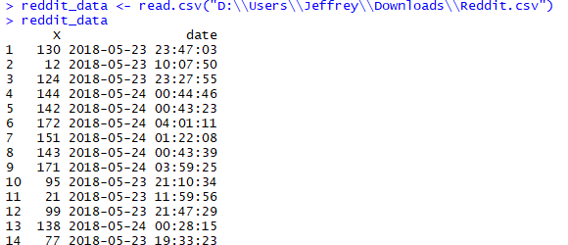
Loading .csv Files into R
In your classes, you will be asked to read in data from .csv files. This is done using the read.csv() function. Note that filepaths require two “\” symbols in Windows! In mac use just one “/”
8
Notes:
8

Slide 9
More Resources
https://www.rstudio.com/resources/cheatsheets/
https://swirlstats.com/
https://www.datacamp.com/
http://tryr.codeschool.com/
Or just ask! jmejiare@chicagobooth.edu or jmckee0@chicagobooth.edu
9
Notes:
9

